Slide 1
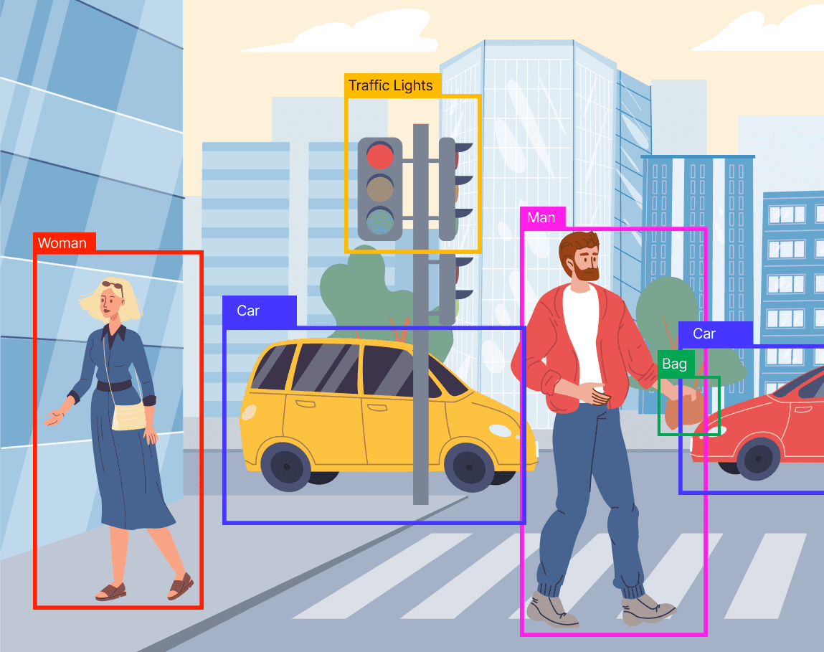
Traffic Object Classification Using Deep Learning
Anthi Zachopoulou
Eirini Ntarouis
Christos Charalampopoulos

Slide 2
Project Overview
Main Goal: Classifying different types of road objects.
Applications: Intelligent traffic monitoring, autonomous vehicles, and collision prevention.

Slide 3
About the dataset
Dataset: Traffic Road Object Detection Polish 12k (Kaggle).
Source: Car camera footage from Polish roads (mainly Kraków).
Scenes: Day/night, highways and city streets.
Focus: Cars, traffic signs, and pedestrians (out of 11 classes).

Slide 4
Steps
Built a model from scratch.
Fine-tuned a pretrained VGG model.
Evaluated our models on new, unseen data.
Trained a second model to compare with our baseline

Slide 5
Data Preprocessing
Removed duplicated images.
Split the data into Train, Val, Test
Cropping via YOLO bounding boxes.
Data augmentation for training set
Jittered crops (+/-15%)
Sharpening
Flipping
Normalization

Slide 6
Classes
 | Train (after augmentation) | Validation | Test
Cars | 1304 | 92 | 120
Traffic Traffic Signs | 800 | 94 | 70
Pedestrian | 180 | 13 | 12

Slide 7
Models Training
SimpleCNN
3 Convolutional Layers (32, 64, 128 filters)
2 Fully Connected Layers (128, 256 neurons): Main source of high parameter count
Batch Normalization & Dropout:
Batch normalization stabilizes and accelerates training;
dropout (0.5) helps prevent overfitting
Total parameters calculated: 8,483,331
DeepCNN
6 Convolutional Layers – block of 2 layers
2 FC Layers (128, 64)
Pooling (Max + AdaptiveAvg):
Max pooling reduces spatial size after each block;
adaptive average pooling shrinks output to fixed size (128)
Batch Normalization & Dropout
Τotal parameters calculated: 148,575
Hyperparameters & model training settings
CrossEntropyLoss, Adam, Epochs: 30, Batch size: 32
Early stopping
The simpleCNN has larger FC layers – this is why it has so higher total parameters count

Slide 8
Detailed Parameter Breakdown
Layer | Parameters
conv1 | 896
bn1 | 64
conv2 | 18,496
bn2 | 128
conv3 | 73,856
bn3 | 256
fc1 | 8,388,864
fc2 | 771
Total | 8,483,331

Slide 9
Evaluation & Results
Metric / Class | SimpleCNN | DeepCNN
Accuracy | 0.88 | 0.82
Macro Avg F1-score | 0.87 | 0.72
Weighted Avg F1-score | 0.88 | 0.82
Car
Precision | 0.86 | 0.82
Recall | 0.95 | 0.91
F1-score | 0.90 | 0.86
Different-Traffic-Sign
Precision | 0.92 | 0.92
Recall | 0.77 | 0.70
F1-score | 0.84 | 0.80
Pedestrian
Precision | 0.91 | 0.44
Recall | 0.83 | 0.58
F1-score | 0.87 | 0.50
Overall Accuracy: SimpleCNN outperforms DeepCNN with 0.88 vs. 0.82 accuracy.
Class-wise Performance: SimpleCNN achieves higher recall and F1-scores for "car" and "Different-Traffic-Sign", and better performance on the "pedestrian" class.
F1-Score Comparison: Macro and weighted F1-scores favor SimpleCNN (0.87 and 0.88) over DeepCNN (0.72 and 0.82).

Slide 10
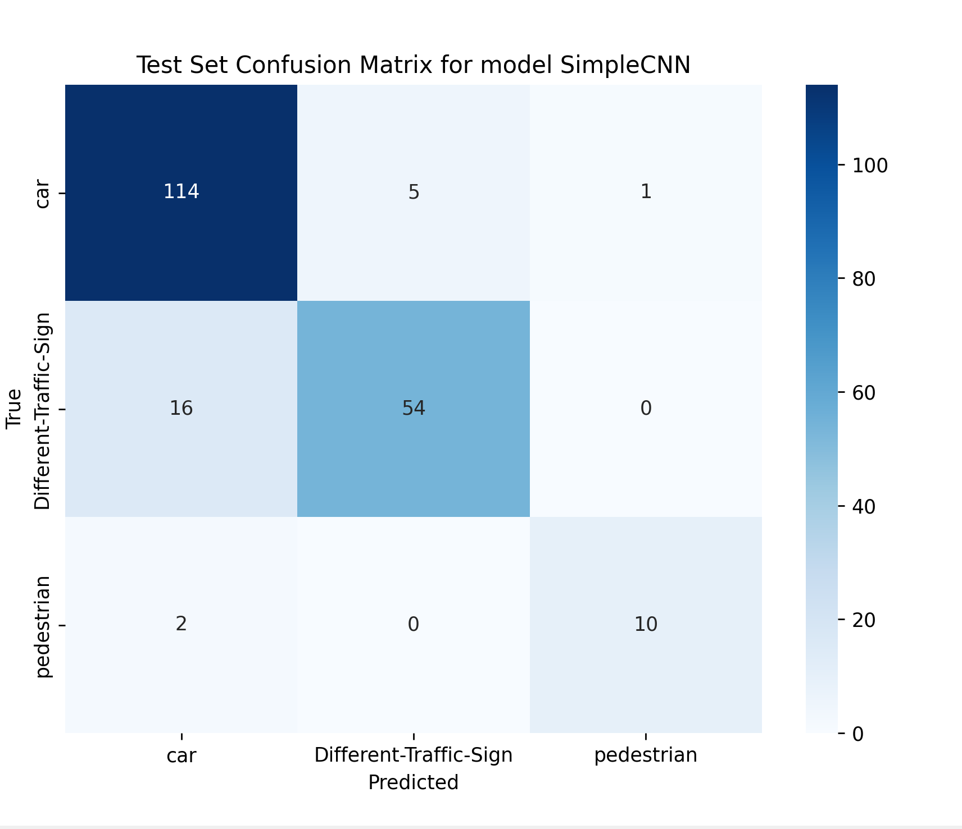
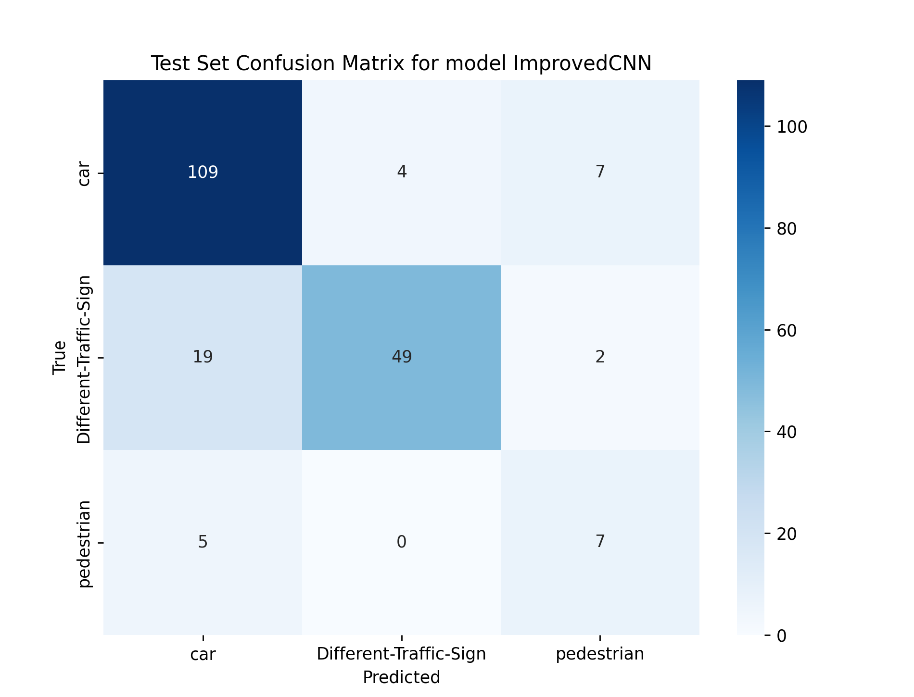
Confusion Matrices

Slide 11
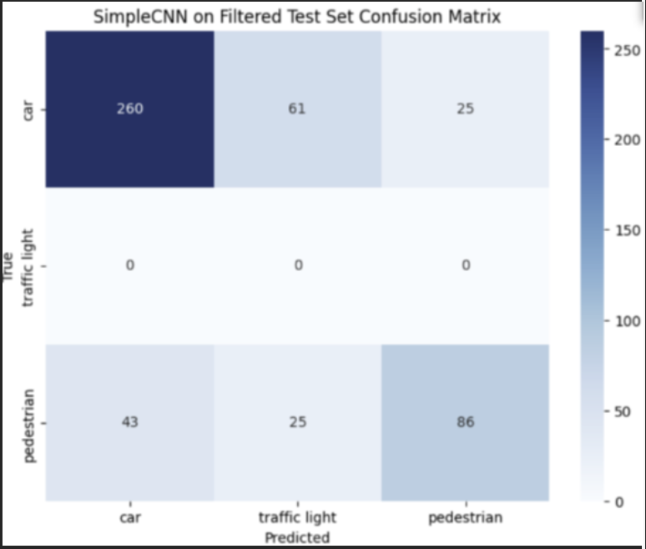
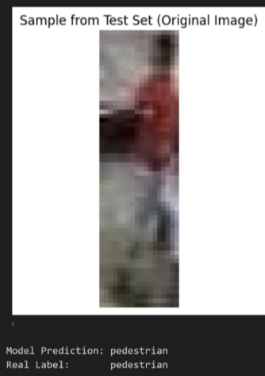
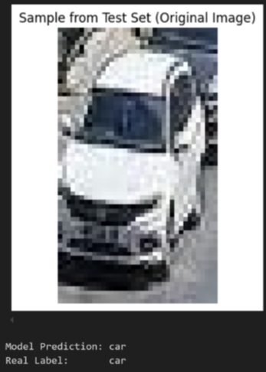
Generalization Test
A new test dataset was used to check if our model generalizes well - cars and pedestrians.
Filter cropped images: minimum 50 pixels for better resolution.
Our best model achieved an accuracy of 69.2%.
Pedestrian class which is the minority, seems to underperform

Slide 12
Transfer Learning with VGG16
1. Model Overview
Architecture: 13 convolutional layers + 3 fully connected layers (total: 16 layers).
Pretrained on: ImageNet (1M+ images).
Used for: Transfer learning
2. Customization
Input images resized to 224×224.
Some preprocessing techniques applied (it actually helped):
Horizontal flipping applied on training set for data augmentation.
Color jitter and occasional grayscale
Convert to tensor & normalize (ImageNet stats)
Frozen feature extractor (convolutional layers); only classifier layers were trained.
Final FC layer replaced to classify 3 target classes (car, pedestrian, traffic sign).

Slide 13
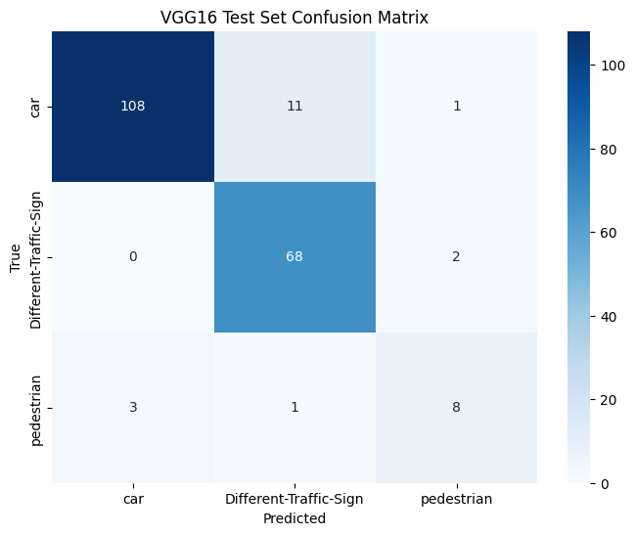
VGG16 Results
Observations
High car accuracy: 108/120 cars correctly classified
Traffic signs: 68/70 correct – much better than our CNN
Slightly weakest on pedestrians: 8/12 correct; 3 misclassified as cars.
Bias toward 'traffic signs': Model tends to over-predict signs class, but it can be due to the small size of the test set.

Slide 14
VGG16 Vs our –from scratch- model
Overall Accuracy: VGG16 achieves 91% vs. bestCNN 88% — a 3% improvement.
Class Sensitivity:
VGG16 is very strong at classifying “Different-Traffic-Sign,” with almost no confusion as “Car.”
Out bestCNN achieves a higher F1-score (0.87) for "pedestrian" vs. VGG16’s ~0.67 (based on confusion matrix).
Model Complexity: SimpleCNN is lightweight and faster to train/infer; VGG16 is deeper and more computationally expensive.
Trade-off Summary: VGG16 offers better top-line accuracy, while our bestCNN balances performance and efficiency

Slide 15


Thank you very much for your time.​
Questions?

